Slide 1
UNIT-I Introduction to Digital marketing
Dr. D. S. Jadhav
Department of Computer Engg., DYPCOE, Pune

Slide 2
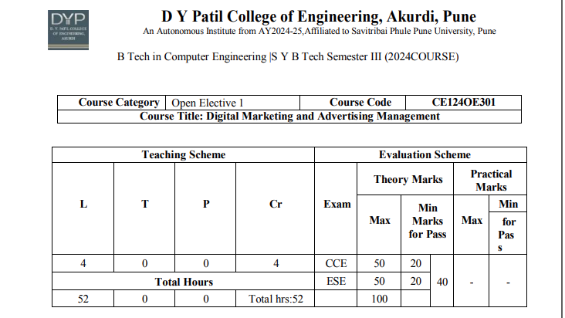

Slide 3
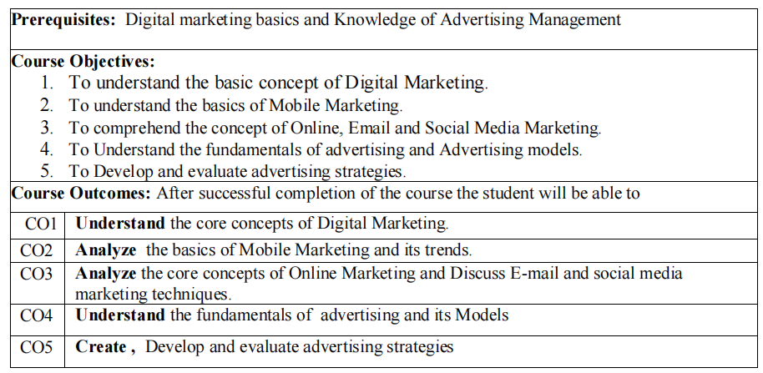
Notes:
Image source: https://www.proideators.com

Slide 4
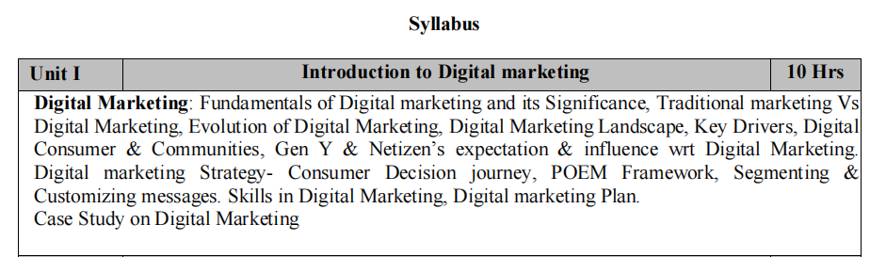
Notes:
Image source: https://www.proideators.com

Slide 5
Fundamentals Of Digital Marketing And Its Significance

Slide 6
Introduction to Digital Marketing
Digital marketing encompasses all marketing efforts that use the internet or electronic devices.
It allows businesses to connect with their target audience through various online channels.
Understanding digital marketing is essential for companies in today's technology-driven world.

Slide 7
Key Components of Digital Marketing
The main components include SEO, content marketing, social media, email marketing, and PPC.
Each component plays a unique role in engaging customers and boosting brand visibility.
A well-rounded digital marketing strategy integrates these components for maximum effectiveness.

Slide 8
Search Engine Optimization (SEO)
SEO involves optimizing website content to rank higher in search engine results.
It focuses on keyword research, on-page optimization, and link-building strategies.
Effective SEO increases organic traffic, enhancing visibility and credibility.

Slide 9
Content Marketing
Content marketing is the creation and distribution of valuable content to attract an audience.
It includes blogs, videos, infographics, and podcasts that provide relevant information.
High-quality content builds trust with customers and encourages engagement and loyalty.

Slide 10
Social Media Marketing
Social media platforms are powerful tools for reaching and engaging with customers.
Brands use social media to create a community, share content, and promote products.
Successful social media marketing increases brand awareness and drives website traffic.

Slide 11
Email Marketing
Email marketing involves sending targeted messages to a segmented audience.
It is one of the most cost-effective digital marketing strategies for customer retention.
Personalized and relevant email content can significantly boost conversion rates.

Slide 12
Pay-Per-Click Advertising (PPC)
PPC is an online advertising model where advertisers pay a fee each time their ad is clicked.
This method allows businesses to reach potential customers instantly and generate immediate traffic.
A well-executed PPC campaign can deliver a high return on investment when managed properly.

Slide 13
Analytics and Data-Driven Marketing
Analytics tools provide insights into customer behavior and campaign effectiveness.
Data-driven marketing helps businesses optimize their strategies based on real-time performance.
Understanding analytics is crucial for making informed decisions and improving ROI.

Slide 14
The Significance of Digital Marketing
Digital marketing is essential for building brand awareness and reaching a global audience.
It allows for targeted messaging, ensuring that marketing efforts are directed toward the right demographics.
In today's competitive landscape, effective digital marketing can distinguish a brand from its competitors.

Slide 15
Future Trends in Digital Marketing
Emerging technologies like AI and machine learning are shaping the future of digital marketing.
Personalization and customer experience will become increasingly important in marketing strategies.
Staying updated with trends is vital for businesses to remain relevant in the digital space.

Slide 16
MCQs on Digital Marketing
What is Digital Marketing? a) Marketing using digital channels like search engines, social media, and email b) Using only radio advertisements c) Distributing flyers door-to-door d) Marketing through print media
What is the primary goal of digital marketing? a) To build brand awareness online b) To increase offline sales c) To reduce online customer support d) To increase print advertising
Which of the following is NOT a type of digital marketing? a) Content marketing b) Print advertising c) Email marketing d) Social media marketing

Slide 17
MCQs on Digital Marketing cont..
4. What does SEO stand for in digital marketing? a) Search Engine Optimization b) Secure Email Operation c) Sales Engagement Online d) Social Engagement Operation
5. What is the primary goal of digital marketing? a) To build brand awareness online b) To increase offline sales c) To reduce online customer support d) To increase print advertising
6. Which of the following is NOT a type of digital marketing? a) Content marketing b) Print advertising c) Email marketing d) Social media marketing

Slide 18
MCQs on Digital Marketing
7. What does PPC stand for in digital advertising? a) Pay Per Content b) Pay Per Promotion c) Pay Per Click d) Print Per Conversion
8. Which of the following is a key benefit of digital marketing? a) Global reach and accessibility b) Higher printing costs c) Decreased brand visibility d) Irrelevant content sharing
9. What is the main goal of social media marketing? a) Print advertisements b) Avoid using visuals c) Distribute newspapers d) Drive website traffic and engagement

Slide 19
MCQs on Digital Marketing
10. Why is Keyword Research important in SEO? a) To ignore search engines b) To understand what terms your audience is searching for c) To create long URLs d) To reduce web traffic

Slide 20
Traditional vs Digital Marketing

Slide 21
MCQs on Traditional vs Digital Marketing
1. Which of the following is a traditional marketing medium?
Instagram B. Google Ads C. Television D. Email Marketing
2. Digital marketing is generally more _______ than traditional marketing.
A. Expensive B. Time-consuming C. Measurable D. Rigid
3. Which of these is NOT a characteristic of traditional marketing?
A. One-way communication B. Higher cost per impression C. Global reach D. Tangible formats (TV, newspaper)

Slide 22
MCQs on Traditional vs Digital Marketing
4. What is a major benefit of digital marketing over traditional marketing?
A. Requires no technical skills B. Allows targeting specific audiences C. Is only accessible to large corporations D. Doesn’t require performance tracking
5. In traditional marketing, feedback from customers is typically:
A. Immediate B. Delayed or limited C. Real-time D. Automated
6. Which of the following offers two-way communication with consumers?
A. Radio B. Newspaper C. Facebook Page D. Television

Slide 23
MCQs on Traditional vs Digital Marketing
7. Which of these is an example of traditional advertising?
A. Sponsored YouTube video B. Billboard on a highway C. Google Display Ad D. Instagram Story ad
8. Which marketing type allows more personalization and segmentation?
A. Traditional Marketing B. Print Marketing C. Event Marketing D. Digital Marketing
9. What is a limitation of traditional marketing?
A. Less reach B. High interactivity C. Advanced analytics D. Personalization

Slide 24
MCQs on Traditional vs Digital Marketing
10. Which of the following platforms is typically used for digital marketing?
A. Radio FM B. LinkedIn C. Magazine D. Flyers

Slide 25
Evolution of Digital Marketing
Pre-Digital Era (Before 1990s) – Traditional Marketing
Channels: Newspapers, TV, Radio, Flyers, Billboards
Focus: Mass marketing & one-way communication
Limitations: Hard to measure, expensive, no targeting

Slide 26
Evolution of Digital Marketing cont..
Emergence of the Internet (1990s) – Birth of Digital Marketing
Milestones:
Websites became common (static HTML)
First clickable banner ad (AT&T, 1994)
Yahoo (1994) and Google (1998) launched
Key Tactics:
Email marketing
Basic website SEO

Slide 27
Evolution of Digital Marketing cont..
Rise of Search Engines and Content (Early 2000s)
Milestones:
Search Engine Marketing (SEM) became central (Google AdWords, 2000)
SEO evolved to improve website visibility
Blogs & content marketing gained popularity

Slide 28
Evolution of Digital Marketing cont..
Social Media Revolution (Mid to Late 2000s)
Platforms:
Facebook (2004), YouTube (2005), Twitter (2006), Instagram (2010)
Strategies:
Social media marketing
Influencer marketing began emerging
Features:
Two-way engagement, user-generated content

Slide 29
Evolution of Digital Marketing cont..
Mobile-First & App-Based Marketing (2010s)
Explosion of mobile users with smartphones and apps
Tactics:
SMS notifications
In-app ads, location-based marketing
Responsive web design for mobile browsing

Slide 30
Evolution of Digital Marketing cont..
Data-Driven & Automation Era (Mid 2010s – Present)
Tools:
Google Analytics, CRMs (e.g., Salesforce, HubSpot)
Marketing Automation Platforms (Mailchimp, Marketo)
Tactics:
Retargeting/Remarketing
Behavior-based personalization
Real-time campaign optimization

Slide 31
Evolution of Digital Marketing cont..
AI, Machine Learning & Voice Search (2020s – Ongoing)
Innovations:
Chatbots, predictive analytics, programmatic advertising
Voice search & smart assistants (Alexa, Google Assistant)
AI-powered content creation (e.g., ChatGPT)
Trends:
Hyper-personalization
Conversational marketing
Video-first strategies (YouTube Shorts, Reels, TikTok)

Slide 32
Evolution Table cont..
Era | Key Innovation | Major Tools/Channels
Pre-1990s | Traditional Ads | TV, Radio, Print
1990s | Internet/Websites | Email, Static Web Pages
Early 2000s | Search Engines | Google Ads, SEO, Blogs
2005–2012 | Social Media | Facebook, YouTube, Twitter
2013–2018 | Mobile & Automation | Apps, SMS, CRM Tools
2019–Now | AI, Voice, Video, Personalization | Chatbots, AI, TikTok, Analytics

Slide 33
Digital Marketing Landscape
Overview of Channels, Tools, and Trends

Slide 34
Digital Marketing Landscape
The digital marketing landscape is a broad ecosystem of tools, platforms, strategies, and technologies used to reach and engage consumers online.
Type | Description | Examples
Owned Media | Channels you control | Website, Blog, App, Email List
Earned Media | Organic publicity, not paid | Reviews, Shares, Mentions, SEO Ranking
Paid Media | Advertising and paid promotions | Google Ads, Facebook Ads, Influencers

Slide 35
Digital Marketing Key Drivers
Widespread Internet Penetration
High-speed internet and smartphone adoption have made it easier for people to access digital platforms anytime, anywhere.
Growing Use of Mobile Devices
Mobile phones are now the primary device for consuming content, searching, shopping, and using social media.
Social Media Engagement
Platforms like Facebook, Instagram, LinkedIn, and TikTok help brands engage users, promote content, and create communities.

Slide 36
Digital Marketing Key Drivers cont..
Data-Driven Marketing
Access to big data and analytics tools allows marketers to understand consumer behavior, segment audiences, and personalize messaging.
Search Engine Dominance
Google and other search engines drive traffic through SEO (Search Engine Optimization) and SEM (Search Engine Marketing), influencing visibility and customer reach.
Content Marketing Boom
High-quality, relevant content in the form of blogs, videos, podcasts, etc., helps attract, engage, and convert audiences.

Slide 37
Digital Marketing Key Drivers cont..
E-commerce Growth
Online shopping growth has driven the need for digital advertising, remarketing, and user experience optimization.
AI and Automation
Tools using AI for chatbots, email campaigns, and customer segmentation increase efficiency and personalization.
Cost-Effective Marketing
Compared to traditional methods, digital marketing offers lower cost per lead and better ROI tracking.

Slide 38
Digital Marketing Key Drivers cont..
Interactive and Real-Time Communication
Two-way communication through comments, messaging apps, and live streams enhances customer experience and brand trust.
Influencer and Affiliate Marketing
Influencers help brands gain trust and expand reach through authentic content and personal connections.
Global Reach and Localization
Digital platforms allow for global campaigns that can be localized based on language, culture, and preferences.

Slide 39
Digital Consumer & Communities in Digital Marketing
Understanding digital consumers and online communities is essential in crafting effective digital marketing strategies. Here's a breakdown of these key concepts: Digital Consumer and Communities.

Slide 40
Digital Consumer in Digital Marketing
A digital consumer is an individual who uses digital technologies (e.g., internet, smartphones, social media) to interact with brands, gather information, and make purchases.
Key Characteristics:
Always Connected – Uses multiple devices (mobile, tablet, desktop).
Informed Decision-Makers – Research products/services before buying.
Seeks Personalization – Expects relevant content and tailored experiences.
Socially Influenced – Trusts reviews, ratings, influencers, and peer opinions.
Omni-channel Behaviour – Moves seamlessly across platforms (website, app, social media, email).

Slide 41
Digital Communities
Digital communities are groups of people connected through shared interests or goals on digital platforms.
Types of Communities:
Brand Communities (e.g., Apple, Nike fans)
Product Review Forums (e.g., Reddit, Quora, Amazon reviews)
Social Media Groups (e.g., Facebook Groups, LinkedIn communities)
Fan & Influencer Communities (e.g., YouTube subscribers, Instagram followers)

Slide 42
Digital Communities
Importance in Marketing:
Trust & Loyalty Building – Fosters emotional connection to the brand.
Word-of-Mouth Promotion – Encourages organic sharing and advocacy.
Customer Feedback & Co-creation – Helps brands improve via suggestions.
Enhanced Brand Reach – Influencers and members help spread content.
Support & Engagement Hubs – Enables peer-to-peer support and active brand dialogue.

Slide 43
Digital Consumer & Communities in Digital Marketing – MCQs
Which of the following best describes a digital consumer? A. Someone who shops only in physical stores B. Someone who only uses television ads C. Someone who uses digital platforms to research, interact, and purchase D. Someone who avoids online communication
Which device is most commonly used by digital consumers today? A. Desktop computer B. Television C. Mobile phone D. Radio

Slide 44
Digital Consumer & Communities in Digital Marketing – MCQs
3. Digital communities are primarily built on: A. Physical networking B. Shared interests and digital interaction C. Corporate advertisements D. Print-based media
4. Why are digital communities important for marketers? A. They reduce the need for data B. They allow direct mail campaigns C. They help build brand loyalty and trust D. They are used only for tech brands

Slide 45
Digital Consumer & Communities in Digital Marketing – MCQs
5. Which of the following is NOT a feature of digital consumers? A. Personalized experience expectation B. Social media influence C. Offline-only shopping behaviour D. Omni-channel presence
6. User-Generated Content (UGC) in digital communities is important because: A. It replaces traditional media B. It lowers product quality C. It adds credibility and authenticity to marketing D. It avoids customer feedback

Slide 46
Digital Consumer & Communities in Digital Marketing – MCQs
7. Which platform is least likely to host digital communities? A. Facebook B. LinkedIn C. Instagram D. Landline telephony
8. Digital consumers rely heavily on the following before purchase: A. Billboard advertisements B. Peer reviews and influencer opinions C. Radio jingles D. Door-to-door sales

Slide 47
Digital Consumer & Communities in Digital Marketing – MCQs
9. What is a major advantage of engaging with digital communities? A. Reduced data collection B. Higher print ad spend C. Direct feedback from users D. Lower product demand
10. Which marketing strategy best utilizes digital communities? A. Cold calling B. TV commercial blasts C. Influencer and community marketing D. Newspaper ads

Slide 48
Gen Y & Netizen’s expectation & influence wrt Digital Marketing
Gen Y and netizens, as digital natives, have specific expectations from digital marketing, primarily centring on authenticity, personalization, and engaging experiences.
They value brands that are transparent, responsive, and relatable, moving beyond traditional advertising to seek genuine connections.
Key expectations include relevant and timely content, seamless user experiences, and opportunities for community and collaboration.

Slide 49
Gen Y & Netizen’s expectation & influence wrt Digital Marketing
Key Aspects of Digital Marketing for Gen Y and Netizens:
Authenticity and Transparency:
Gen Y and netizens are highly attuned to genuine brand messaging and are quick to dismiss inauthentic or overly promotional content.
Engagement and Interactivity:
They prefer interactive content, personalized experiences, and opportunities to engage with brands directly.
Social Media Savvy:
Social media platforms are a primary channel for Gen Y and netizens, making it crucial for brands to have a strong presence and engage actively.

Slide 50
Gen Y & Netizen’s expectation & influence wrt Digital Marketing
Content is King:
High-quality, relevant, and engaging content that aligns with their values and interests is essential for capturing their attention.
Personalization:
Tailoring marketing messages and offers to individual preferences and behaviors is important for creating a positive experience.
Influencer Marketing:
Collaborating with relevant influencers can help reach wider audiences and build trust within the community.

Slide 51
Digital Marketing Strategy & the Consumer Decision Journey
The Consumer Decision Journey (also known as the Customer Buying Journey) consists of multiple stages that a customer moves through before, during, and after making a purchase. Digital marketing strategies can be mapped to each stage to guide, engage, and convert consumers.

Slide 52
1. Awareness Stage
The consumer becomes aware of a problem or need.
Digital Marketing Strategies:
Search Engine Marketing (SEM) & SEO
Social Media Advertising
Display Ads & Video Ads (YouTube, Instagram)
Influencer Marketing
Content Marketing (Blogs, Explainers)
Goal: Get discovered and build brand visibility.

Slide 53
2. Consideration Stage
The consumer researches options and evaluates brands.
Digital Marketing Strategies:
Email Campaigns with comparisons, guides, or testimonials
Retargeting Ads (Google, Facebook Pixel)
Product Demo Videos & Webinars
Online Reviews and Testimonials
Landing Pages with CTAs and Lead Magnets
Goal: Stay in the consumer's consideration set by providing value and information.

Slide 54
3. Purchase Stage
The consumer makes the decision to buy.
Digital Marketing Strategies:
E-commerce Optimization
Special Offers, Coupons & Discounts
Mobile-Optimized Checkout Experience
Live Chat & Chatbots for Instant Help
Abandoned Cart Email Sequences
Goal: Simplify the buying process and drive conversions.

Slide 55
4. Post-Purchase Stage
The consumer makes the decision to buy.
Digital Marketing Strategies:
E-commerce Optimization
Special Offers, Coupons & Discounts
Mobile-Optimized Checkout Experience
Live Chat & Chatbots for Instant Help
Abandoned Cart Email Sequences
Goal: Simplify the buying process and drive conversions.

Slide 56
What is the POEM Framework?
The POEM framework in digital marketing stands for Paid, Owned, and Earned media.
It's a strategic approach that helps marketers understand and utilize different media channels to achieve their marketing goals.
By effectively balancing these three elements, businesses can optimize their online presence, reach a wider audience, and drive better results.

Slide 57
Here's a breakdown of each component:
POEM stands for:
• Paid Media
• Owned Media
• Earned Media
It helps brands plan, integrate, and optimize media strategies.

Slide 58
Paid Media
This involves paying for advertising space or placements to promote your brand.
Examples include:
Search Engine Advertising: Pay-per-click (PPC) campaigns on platforms like Google or Yahoo.
Social Media Advertising: Running ads on platforms like Facebook, Instagram, or TikTok.
Influencer Marketing: Collaborating with influencers to promote your products or services for a fee.

Slide 59
Owned Media
This refers to the channels and content that your brand directly controls, such as:
Your Website: A central hub for your brand's online presence, including information about your products or services
Blog: Sharing valuable content related to your industry, which can attract organic traffic and establish your brand as a thought leader.
Social Media Profiles: Engaging with your audience, sharing updates, and building a community around your brand.

Slide 60
Earned Media
This is the publicity and brand mentions you receive through word-of-mouth, social sharing, and media coverage. It's essentially free advertising that you gain through positive customer experiences or compelling content. Examples include
Customer Reviews: Positive reviews on platforms like Google, Yelp, or Amazon.
Social Media Shares: When users organically share your content on their social media profiles.
Media Mentions: Articles or blog posts featuring your brand in reputable publications or websites.

Slide 61
How the POEM Framework Works:
The POEM framework helps marketers create a holistic digital marketing strategy by considering the strengths and weaknesses of each media type. By integrating these elements, businesses can:
Increase Brand Awareness:
Paid media can quickly reach a large audience, while owned media helps build a strong online presence.
Drive Traffic and Engagement:
Owned media channels can attract organic traffic through SEO and content marketing.
Build Credibility and Trust:
Earned media provides social proof and builds trust through positive customer experiences and media mentions.
Convert Leads and Sales:
By strategically guiding potential customers through the customer journey, businesses can increase the likelihood of conversions.

Slide 62
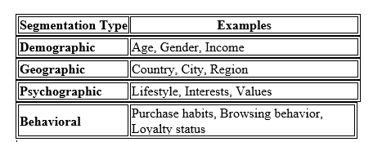
Segmenting & Customizing Messages in Digital Marketing
What is Segmentation?
Market segmentation is the process of dividing a broad target audience into smaller, more defined groups based on shared characteristics, such as:

Slide 63
Segmenting & Customizing Messages in Digital Marketing
What is Segmentation?
Market segmentation is the process of dividing a broad target audience into smaller, more defined groups based on shared characteristics, such as:
Purpose: To better understand customer needs and deliver more relevant marketing messages.

Slide 64
Segmenting & Customizing Messages in Digital Marketing
What is Message Customization?
Customization involves tailoring the marketing message for different customer segments to improve relevance and engagement.
Examples:
Sending personalized emails with the recipient’s name and relevant offers.
Showing product recommendations based on previous browsing or purchase behaviour.
Running location-specific ads in different regions or cities.

Slide 65
Tools Used for Segmentation & Customization
CRM Systems (e.g., Salesforce, HubSpot)
Email Marketing Tools (e.g., Mailchimp, MoEngage)
Web Analytics (e.g., Google Analytics, Hotjar)
Social Media Platforms (e.g., Facebook Ads Manager for audience targeting)

Slide 66
Real-World Examples
Amazon: Product suggestions based on browsing and buying behaviour.
Netflix: Customizes homepage based on viewing habits.
Spotify: Personalized playlists and ads based on listening behaviour.

Slide 67
MCQs
1. What is the first stage in the consumer decision journey?
A) Evaluation of alternatives B) Purchase decision C) Awareness D) Post-purchase behavior
2. Which of the following best describes the 'Consideration' stage in the consumer decision journey?
A) The consumer becomes aware of a product. B) The consumer evaluates different products or brands. C) The consumer makes a purchase decision. D) The consumer shares feedback post-purchase.

Slide 68
MCQs
3. What role does 'Social Proof' play in the consumer decision journey?
A) It decreases consumer trust. B) It has no impact on consumer decisions. C) It builds credibility and trust through testimonials and reviews. D) It confuses consumers with too much information.
4. What is the final stage of the consumer decision journey?
A) Purchase B) Awareness C) Consideration D) Loyalty/Post-purchase behaviour

Slide 69
MCQs
5. Which of the following is an example of owned media? A) A Facebook ad campaign B) A review on a consumer blog C) Your brand’s homepage and blog D) A customer share on social media
6. Earned media is best described as: A) Paid influencer posts B) Content on your blog C) Organic mentions, shares, and reviews D) Paid social media ads

Slide 70
MCQs
7. Which of the following correctly matches the component with its benefit? A) Paid = builds trust; Earned = immediate traffic B) Owned = you control; Paid = organic credibility C) Earned = trustworthy and viral; Owned = long-term engagement D) Paid = free exposure; Owned = external reviews
8. A startup wants a balanced digital marketing strategy under POEM. Which action aligns to all three media types? A) Launch a PPC campaign, run a blog, and encourage user reviews B) Only use paid social ads C) Share reviews and ignore owned channels D) Post randomly on social media without direction

Slide 71
MCQs
9. Which media type is often hardest to control yet most trusted by consumers? A) Paid Media B) Owned Media C) Earned Media D) Shared Media
10. A start-up wants a balanced digital marketing strategy under POEM. Which action aligns to all three media types? A) Launch a PPC campaign, run a blog, and encourage user reviews B) Only use paid social ads C) Share reviews and ignore owned channels D) Post randomly on social media without direction

Slide 72
MCQs
11. In the POEM framework, how can content marketing in owned media support earned media? A) By paying influencers to write reviews B) By publishing high-value content that others share C) By ignoring website updates D) By focusing only on display ads
12. What is primary purpose of market segmentation? A) To create one message for all customers B) To divide customers into groups with shared characteristics C) To customize messages to one individual without grouping D) To standardize marketing messages

Slide 73
MCQs
13. Customization in digital marketing refers to: A) Segmenting customers based on past purchases B) Allowing customers to input preferences to shape messages C) Predicting behavior through data analysis D) Sending the same message to all segments
14. How does customization differ from personalization? A) Customization is made by user input; personalization is algorithm-driven B) Customization uses machine learning; personalization uses static segments C) Customization targets groups; personalization targets segments D) Customization focuses on behavior; personalization on demographics

Slide 74
MCQs
15. Which type of messaging technique adds a user’s name into marketing content? A) Segmentation B) Customization C) Personalization D) None of the above
16. What is a key benefit of message customization? A) Reduces the need for customer data B) Allows customers to feel control over their experience C) Always yields higher conversion than personalization D) Simplifies segment creation by marketers

Slide 75
MCQs
17. Which statement best describes the relationship between segmentation, customization, and personalization? A) They are different terms for the same process B) Segmentation groups customers; customization is user‑selected; personalization tailors individual messages with data C) Personalization comes before segmentation and customization D) Customization cannot be used without segmentation

Slide 76
Skills In Digital Marketing
Digital marketing requires a diverse set of skills, encompassing technical, analytical, and creative abilities.
Key skills include SEO, content creation, social media management, data analysis, PPC advertising, and email marketing.
Strong communication and adaptability are also essential for success in this dynamic field.

Slide 77
Skills In Digital Marketing
Technical Skills:
SEO (Search Engine Optimization):
Optimizing website content to rank higher in search engine results.
PPC Advertising:
Managing paid advertising campaigns on platforms like Google Ads and Facebook.
Email Marketing:
Creating and executing effective email campaigns to engage and nurture customers.
Social Media Management:
Managing social media presence, engaging with audiences, and running campaigns.
Content Creation:
Writing, designing, and producing engaging content for various digital platforms.

Slide 78
Skills In Digital Marketing
Technical Skills:
Digital Analytics:
Utilizing tools like Google Analytics to track website performance and user behavior.
CRM (Customer Relationship Management):
Managing customer interactions and data to improve marketing efforts.
AI and ML (Artificial Intelligence and Machine Learning):
Understanding how these technologies can be leveraged for marketing automation and personalization.
Web Design:
Basic understanding of web design principles for creating visually appealing digital content

Slide 79
A digital marketing plan
A digital marketing plan is a comprehensive document that outlines a company's online marketing strategy to achieve specific business goals.
It details the objectives, target audience, chosen channels, budget, and timelines for all digital marketing activities.
Think of it as a roadmap that guides your online marketing efforts to ensure efficiency and effectiveness.

Slide 80
A digital marketing plan
Define Objectives and Goals:
Establish clear, measurable, achievable, relevant, and time-bound (SMART) objectives that align with your overall business goals.
Examples include increasing website traffic, generating leads, boosting sales, or enhancing brand awareness.
Understand Your Target Audience:
Create detailed buyer personas based on research and data to understand your ideal customers.
Consider demographics, interests, online behavior, and purchase motivations.

Slide 81
A digital marketing plan
Conduct a Digital Audit:
Evaluate your current online presence, including your website, social media, content, and other digital assets.
Identify strengths, weaknesses, opportunities, and threats (SWOT analysis).
Choose Your Digital Marketing Channels:
Determine which channels are most relevant to your target audience and goals.

Slide 82
A digital marketing plan
Common channels include:
Search Engine Optimization (SEO): Improve your website's visibility in search engine results pages (SERPs).
Paid Advertising (PPC): Utilize platforms like Google Ads to drive traffic and conversions.
Social Media Marketing: Engage with your audience on relevant social media platforms.
Content Marketing: Create and distribute valuable content to attract and engage your audience.
Email Marketing: Nurture leads and build relationships with your audience through email campaigns.

Slide 83
A digital marketing plan
Develop a Content Strategy:
Plan the type, format, and frequency of content you will create and distribute.
Consider blog posts, articles, videos, infographics, and other relevant content formats.
Set a Budget:
Allocate resources to each chosen channel and activity.
Consider both paid and organic marketing efforts.

Slide 84
A digital marketing plan
Establish Key Performance Indicators (KPIs):
Identify metrics that will help you track your progress and measure the success of your plan.
Examples include website traffic, conversion rates, lead generation, and social media engagement.
Implement and Monitor:
Execute your digital marketing plan according to your defined strategies and timelines.
Regularly monitor your KPIs and make adjustments as needed.

Slide 85
A digital marketing plan
Analyze and Optimize:
Analyze your results and identify areas for improvement.
Continuously optimize your plan based on your findings to maximize your results.
Integrate with Overall Marketing Strategy:
Ensure your digital marketing plan aligns with your overall business and marketing objectives.

Slide 86
MCQs: Skills in Digital Marketing
Which skill is identified as most crucial by marketers entering the field?
A) Graphic design B) SEO knowledge C) Public speaking D) Video production
What is considered the most essential skill for modern digital marketing roles?
A) Video editing B) Google Analytics and data interpretation C) Email template designing D) Offline advertising

Slide 87
MCQs: Skills in Digital Marketing
Digital marketers see analytics and strategy as two types of skills. Which are technical, and which are strategic?
A) Content writing is strategic, email marketing is technical B) SEO tools and platform use are technical; creativity, leadership, decision-making are strategic C) Data visualization is technical; budget planning is strategic D) Graphic design is strategic; ROI reporting is technical
Which skill is highlighted as critical for optimizing digital marketing campaigns and improving efficiency?
A) Copywriting B) Marketing automation knowledge C) Video production D) Event planning

Slide 88
MCQs: Skills in Digital Marketing
What combination of skills is widely recommended for aspiring digital marketers, especially beginners?
A) SEO, social media, and pay-per-click B) SEO, data analytics, and content creation C) Graphic design, UX, and coding D) Leadership, budgeting, and design

Slide 89
MCQs: Digital Marketing Plan & Strategy
What is the primary objective of a digital marketing strategy? A) To increase social media followers B) To define the overall approach for achieving specific digital marketing goals C) To plan offline events D) To exclusivement focus on influencer marketing
Which component is essential in a digital marketing plan? A) Office decoration budget B) Digital marketing objectives (e.g. KPI setting) C) Employee satisfaction metrics D) Packaging design

Slide 90
MCQs: Digital Marketing Plan & Strategy
What is a SWOT analysis used for in planning marketing strategies? A) Tracking website traffic B) Identifying Strengths, Weaknesses, Opportunities, Threats C) Measuring social media likes D) Evaluating inventory levels
Which metric is most commonly used to assess the success of digital marketing campaigns? A) Number of staff meetings B) Revenue generated from digital channels C) Inventory turnover D) Office attendance rates

Slide 91
MCQs: Digital Marketing Plan & Strategy
What is the purpose of setting KPIs (Key Performance Indicators) in a plan? A) To manage employee schedules B) To evaluate effectiveness of marketing activities C) To decide office hours D) To plan product packaging

Slide 92
Case Study on Digital Marketing
https://digitalscholar.in/dominos-digital-marketing-strategies/?utm_source=chatgpt.com
https://digitalscholar.in/coca-colas-digital-marketing-strategies/?utm_source=chatgpt.com

